Slide 1
Stylometry and topic modelling of Andrew Lloyd Webber’s musicals
Olga Pichuzhkina,
School of Linguistics, HSE

Slide 2
Material:
Lyrics of 19 musicals with music written by Andrew Lloyd Webber (lemmatized with NLTK for topic modelling). Sources vary: main -- https://www.allmusicals.com
Note: some of the lyrics are incomplete.
Results are located at the: https://github.com/vyhuholl/DH-final-colloquium
Tools: stylo, mallet, gephi, easylinavis (for network analysis of two main pieces).

Slide 3
Stylometry
Lyrics authors -- Tim Rice (main), Alan Ayckbourn, Don Black, David Yazbek, T. S. Eliot, Richard Stilgoe, Richard Maltby, Charles Hart, Trevor Nunn, Christopher Hampton, Jim Steinman, Ben Elton, David Zippel, Glenn Slater, E. Y., Harburg.
Musicals with more than one author are duplicated.

Slide 4
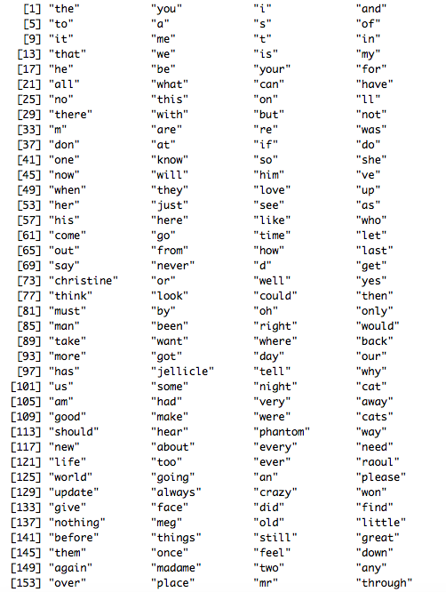
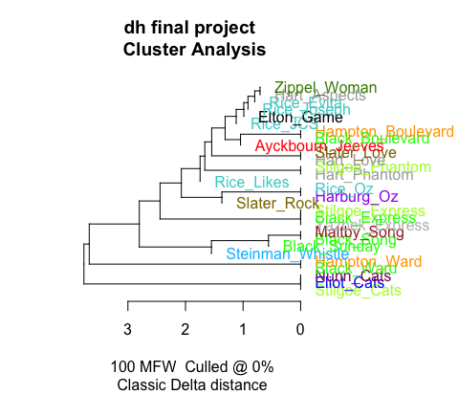
Stylometry: results
Frequency list
Nothing distinguishable.

Slide 5
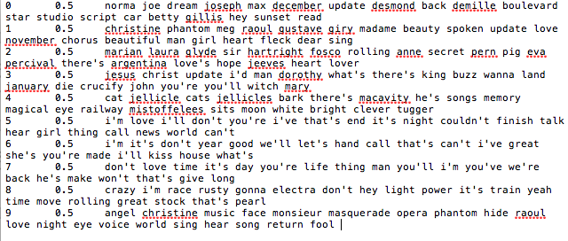
Topic modelling: topics

Slide 6
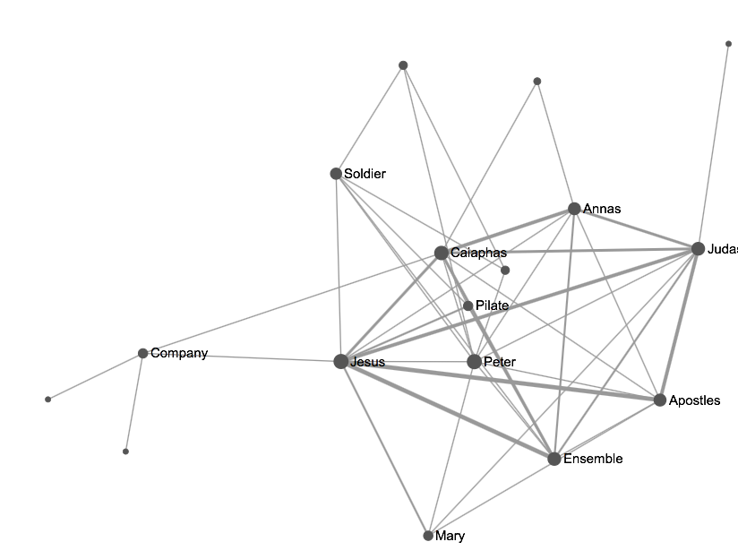
Network Analysis: Jesus Christ Superstar
1 song -- 1 scene

Slide 7
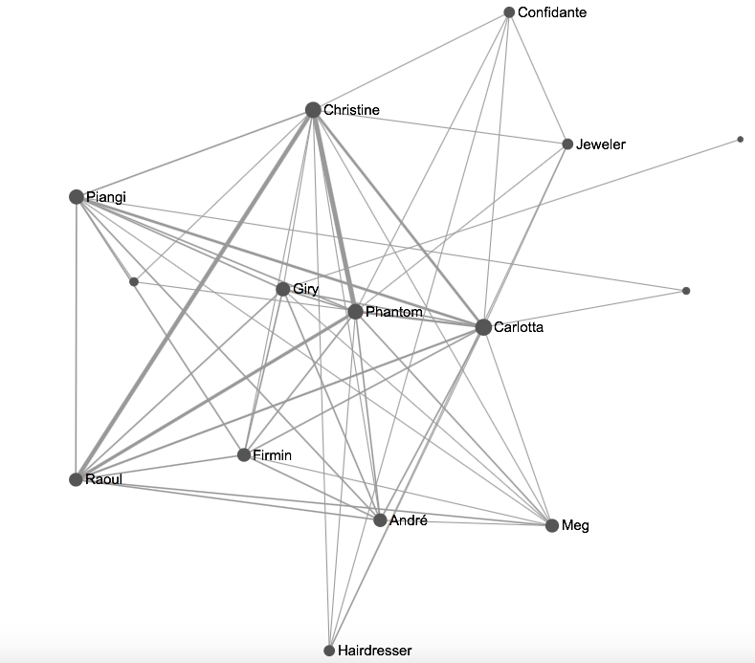
Network Analysis: The Phantom of the Opera
1 song -- 1 scene

